Slide 1
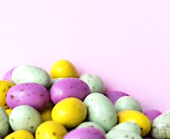
There’s an egg on the big white table
There’s an egg on the big white table.
Where ?
Next to the big blue chair.**
There’s an egg under the purple sofa.
Where ?
Next to the big blue chair.**
There’s a bunny behind the black TV.
Where ?
Next to the brown cupboard.**
There’s a bunny in the small pink drawer
Where ?
Next to the brown cupboard.**

