Slide 1
My Prediction for an American Olympic Medal

Slide 2
My prediction for a medal …

Slide 3
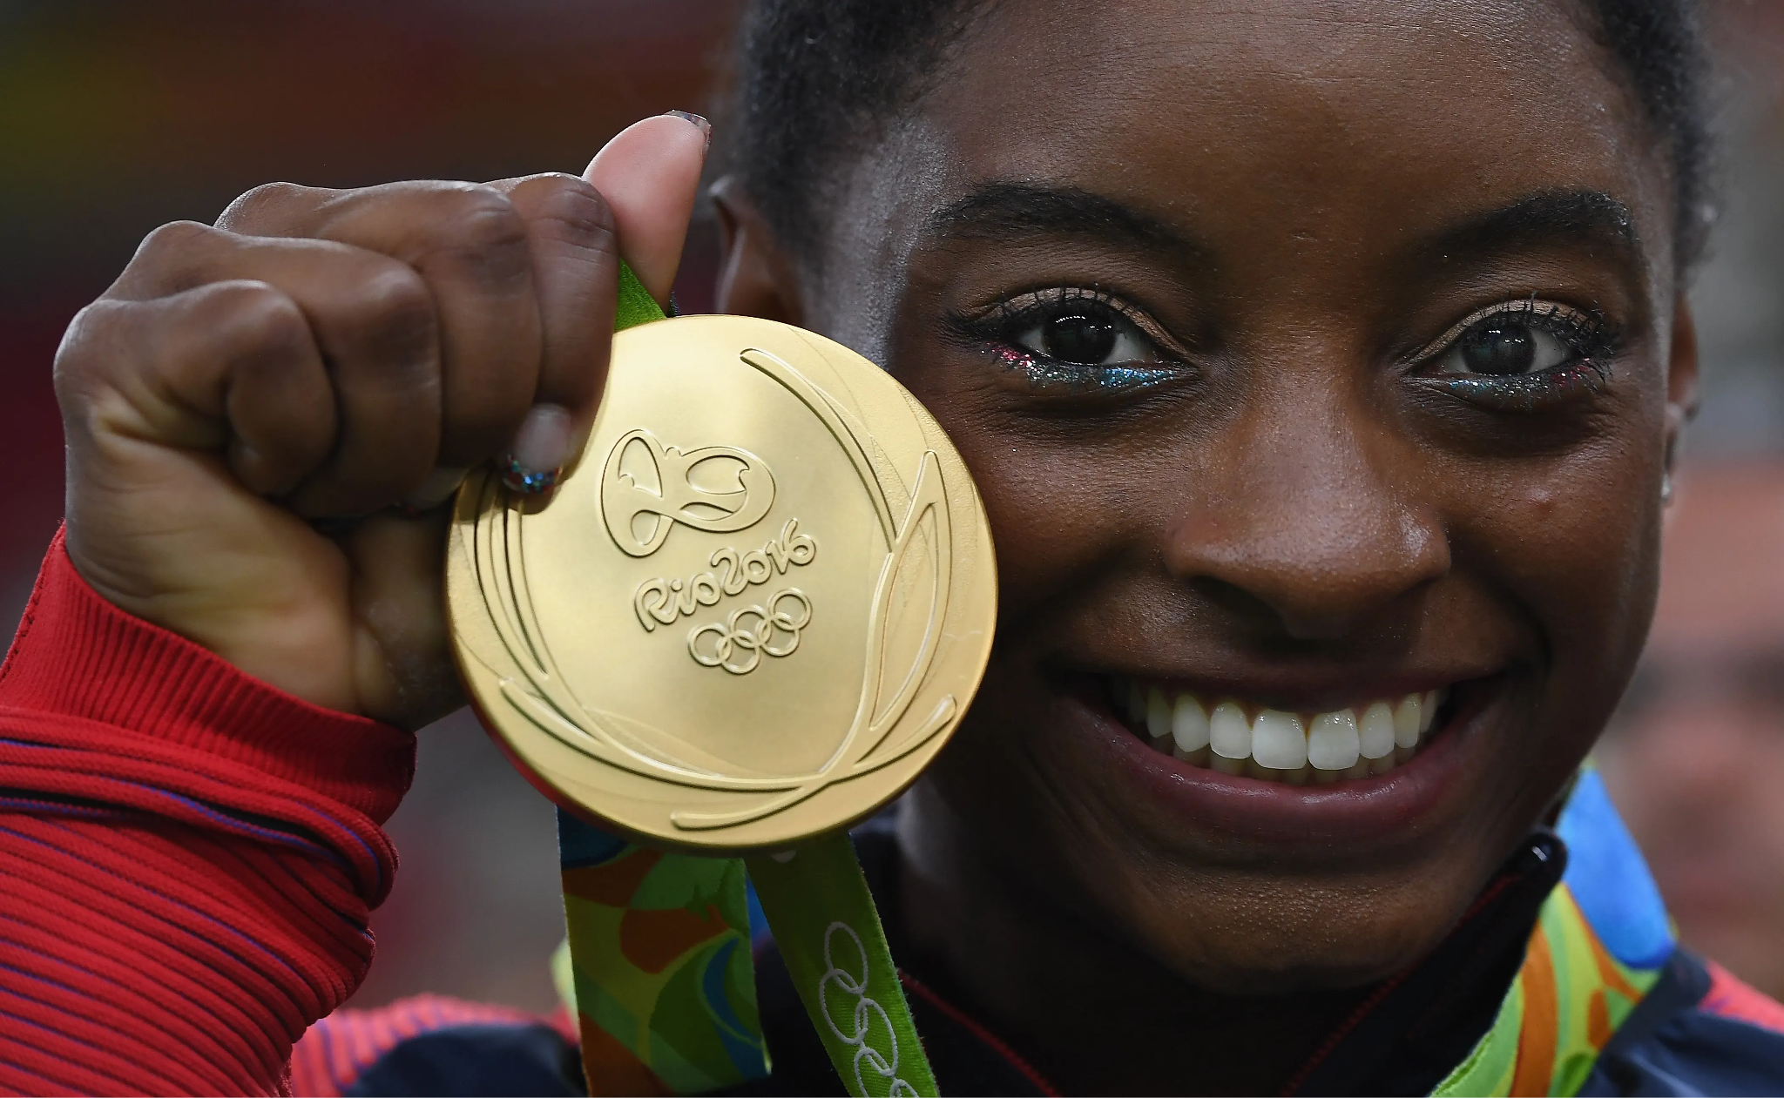
My prediction for a medal…
Name: Simone Biles
Age: 25
Birthday: March 14th, 1997
Nationality: American
…..
Photo

Slide 4
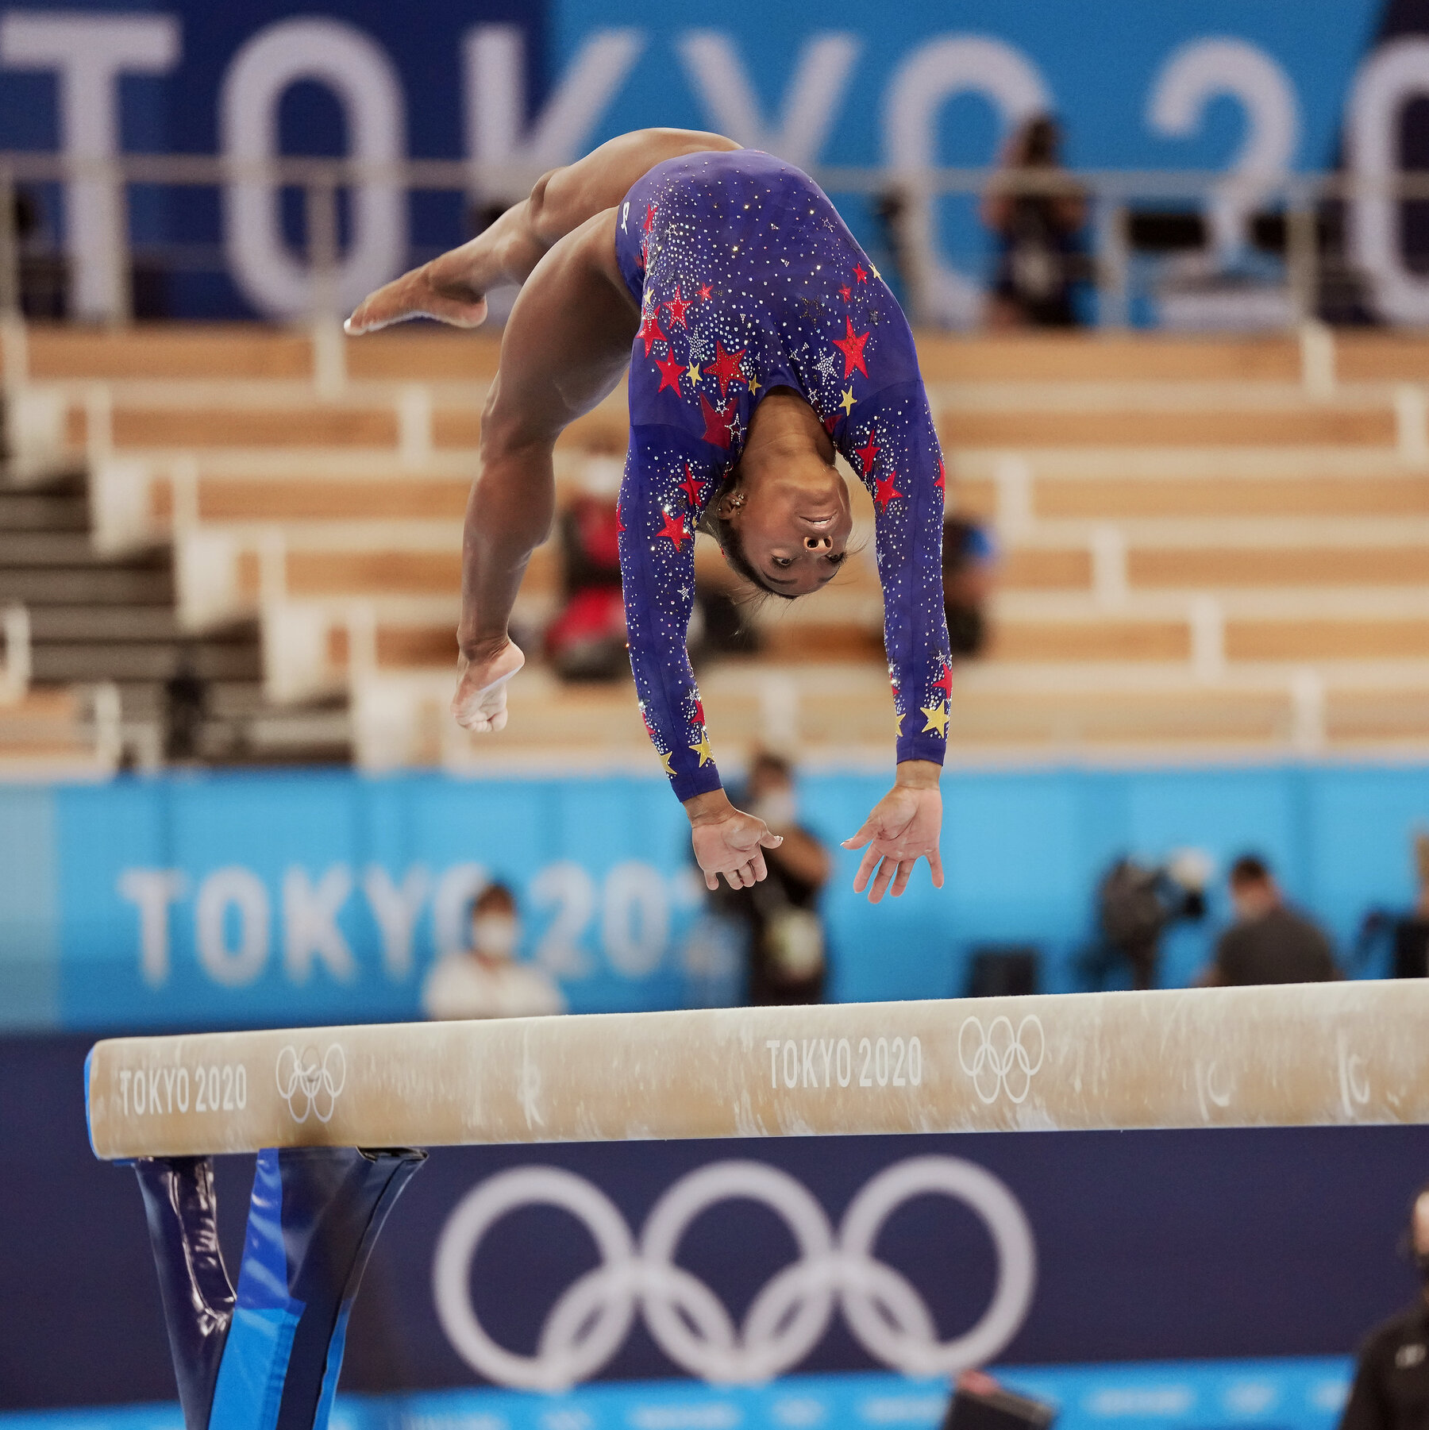
My prediction for a medal …
Photo du sport

