Slide 1
My prediction for an American medal

Slide 2
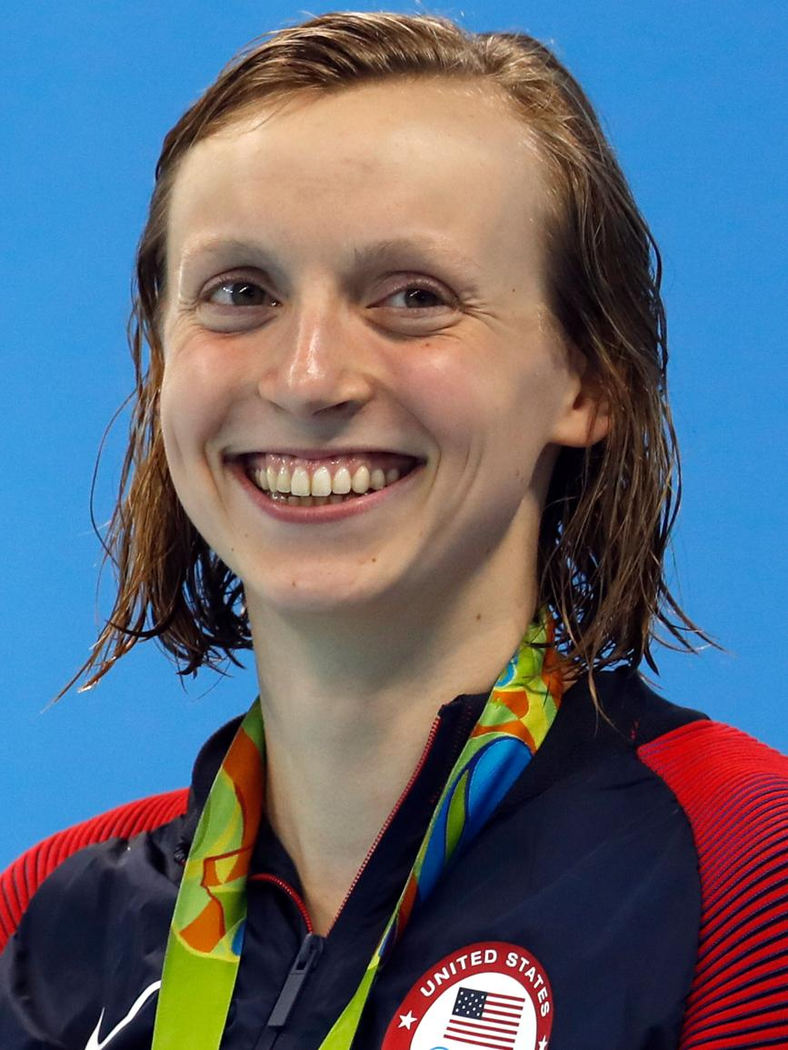
My prediction for an American medal

Slide 3
My prediction for an American medal
Name: Katie Ledecky
Age: 26 years old
Birthday: 03/17/1997
Nationality: American
Accomplishments: 6 olympic gold medals across 2012, 2016, and 2020
Holds the records for the most individual gold medals won by a female swimmer.
Katie Ledecky
Photo

Slide 4
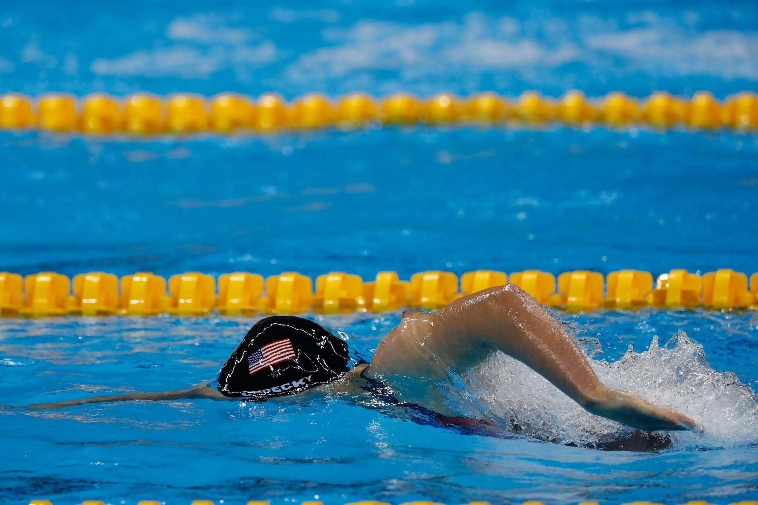
My prediction for an American medal
Swimming:
4 different strokes : freestyle, backstroke, breaststroke, and butterfly.
Individual:
Long course : 50m, 100m, 200m, 400m, 800m, 1500m
Marathon: 10km
Relay
A relay is 4 members of a team each swimming one portion of the race.
A medley relay is each member of the team swims a different stroke for their turn.

