Slide 5
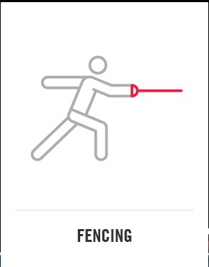

Slide 6
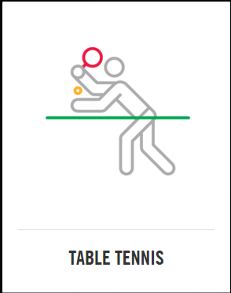

Slide 8
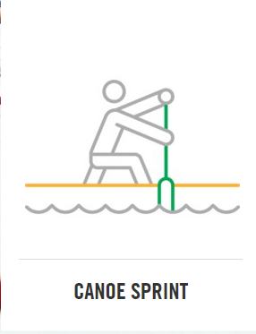

Slide 11
BRONZE MEDAL

Slide 12
SILVER MEDAL

Slide 13
GOLD MEDAL

