Slide 1

Listen…

Slide 2
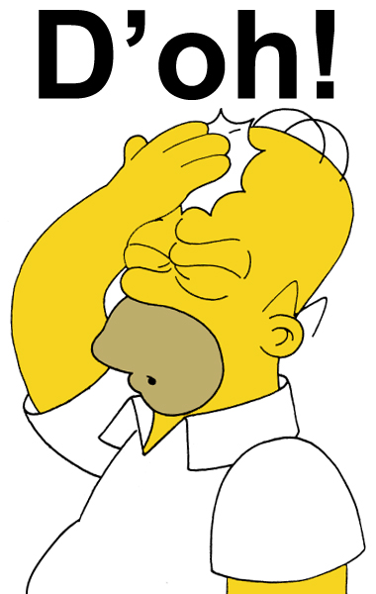
Do you know who’s crying?
It’s Homer Simpson!

Slide 3

Listen again
Do you hear any difference?
The french voice says:
« T’oh! »
The american voice says:
« D’oh! »

Slide 4
Let’s play
« D’Oh » game!

Slide 5
What do you need?
-a board and a marker
- one die
- a partner

Slide 6
Addition:
At the most to the best!

Slide 7
First die roll
score=2
second die roll
2 + 3 = 5
third die roll
5 + 4 = 9
fourth die roll
9 + 5= 14
fifth die roll
14 + 6= 20
sixth die roll
score= 0 !!!

Slide 8

Rules
Roll the die: the most begins
first team = 6 rolls max!
You can stop when you want
You get a D’oh: You’re done / other team begins
Second team: tries to beat the score! (6 rolls max)
Count the final scores

Slide 9
subtraction:
At least at best

Slide 10
First die roll
60-2=58
second die roll
58- 3 = 55
third die roll
55 - 4 = 51
fourth die roll
51 - 5= 46
fifth die roll
46 - 6= 40
sixth die roll
score= 60 !!!

